Slide 1
Part 03 Connecting with Customers
Chapter 6
Analyzing Consumer Markets

Slide 2

Consumer Behavior
Study of how individuals, groups, and organizations select, buy, use, and dispose of goods, services, ideas, or experiences to satisfy their needs and wants.
Marketers must fully understand both the theory and the reality of consumer behavior.

Slide 3
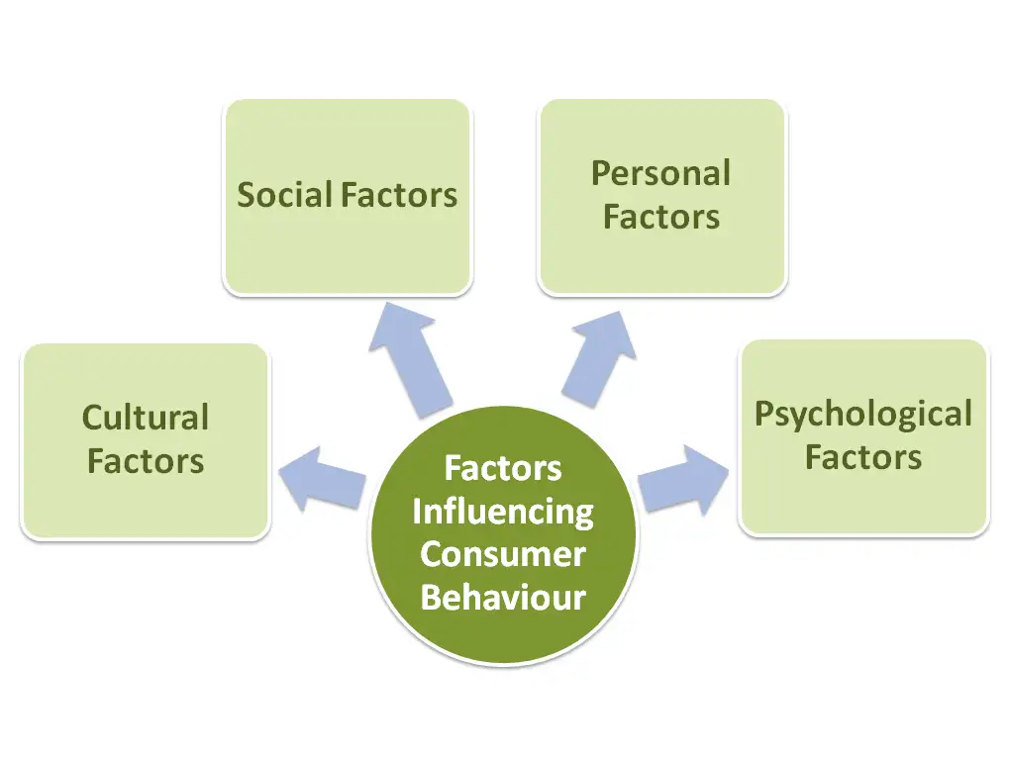
What Influences Consumer Behnvlorż
Factors Affecting Consumer Behavior

Slide 4
Also known “stimulus-response model” Considered the starting point for consumer behavior.
understanding

Slide 5
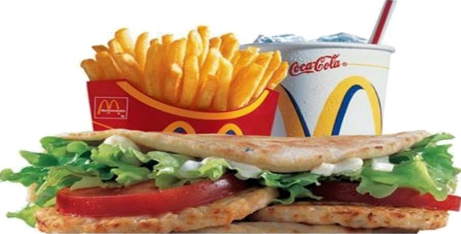
Culture Factors:
What is Culture?
Marketers must closely attend to cultural
values in
every country to understand how to best market their existing products and find opportunities for new products

Slide 6
Culture Factors:
When subcultures grow large and giant enough, companies often design specialized marketing programs to serve them.

Slide 7
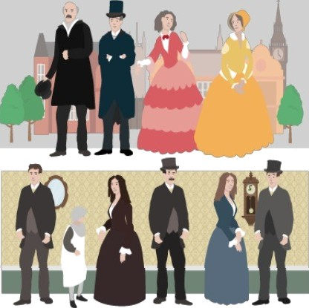

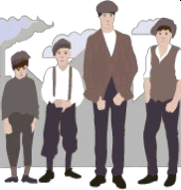

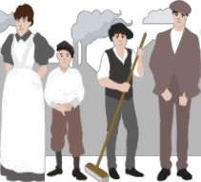
Culture Factors:
Social Classes:
Upper uppers
Lower uppers
Upper middles
Working class
Upper lowers
Lower lowers

Slide 8
Social Factors: Reference Groups Family - Affecting Buying Decisions For expensive products and services (cars, vacations, or housing) the vast majority of husbands and wives engage in joint decision making Men and women may respond differently to marketing messages.

Slide 9

Social Factors:
Roles & Status
We can define a person's position in each group in terms
of role and status.
A role consists of the activities a person is expected to perform.
Each role in turn connotes a status.
People choose products reflect and communicate
that their
role and their actual or desired status in society.
Marketers must be aware of the status-symbol potential of products and brands.

Slide 10


Personal Factors
Age and stage in the life cycle
Personality and self-concept,

Slide 11
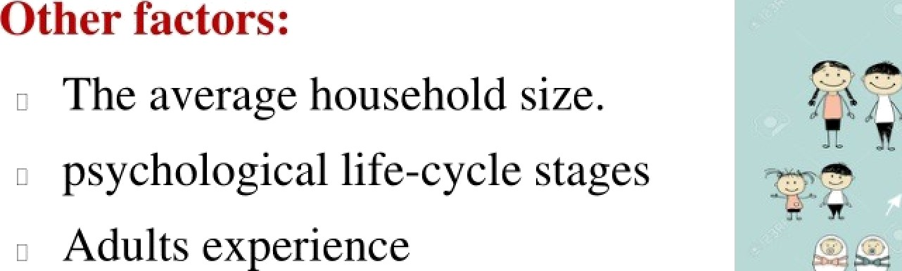












Personal Factors:
Age and stage in the life cycle
Marketers should also consider critical
life events or transitions as giving rise to *
new needs.
(marriage, childbirth, illness, relocation, divorce, first .job, career change, retirement, death of a spouse)

Slide 12
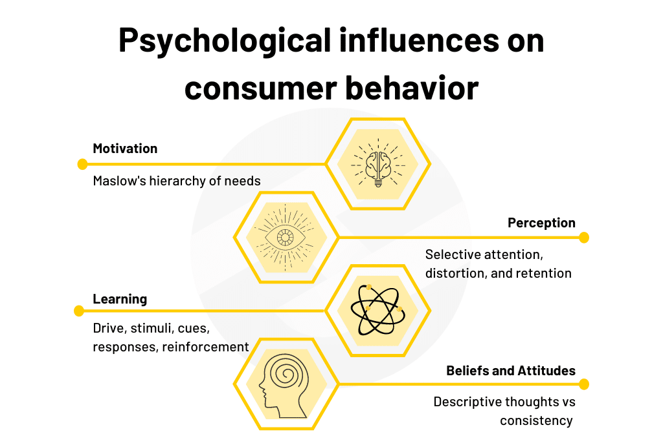
Psychological Factors
Perception
Motivation
Learning
Attitude
Personality

Slide 13
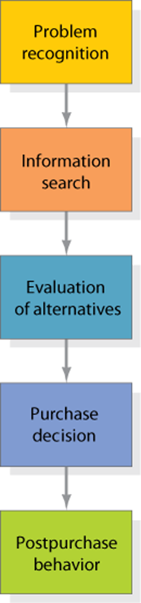
Consumer Decision Buying Process
Clearly, the buying process starts long before the actual purchase and has consequences long afterward.
Some consumers passively shop and may decide to make a purchase from unsolicited information they encounter in the normal course of events.
Recognizing this fact, marketers must develop activities and programs that reach consumers at all decision stages.

Slide 14
Consumer Decision Buying Process
(1)
Problem/Gap/Need Recognition
Marketers need to:
Identify the circumstances that trigger a particular need
by gathering information from a number of consumers.
Develop marketing strategies that spark consumer interest.
Particularly for discretionary purchases such as luxury goods, vacation packages, and entertainment options, marketers may need to increase consumer motivation so a potential purchase gets serious consideration.

Slide 15
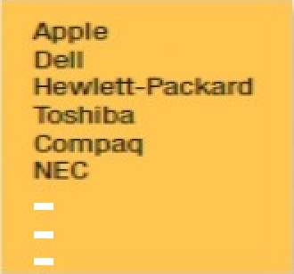
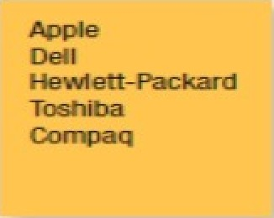

Consumer Decision Buying Process
(2)
Information Search
The first box shows the total set of brands available.
The individual consumer will come to know a subset of these, the
awareness set.
Only some, the consideration set, will meet initial buying
criteria.
As the consumer gathers more information, just a few, the choice
set, will remain strong contenders.
The consumer makes a final choice from these.

Slide 16
(3)
Consumer Decision Buying Process
Evaluation of alternatives
Criteria for Evaluations:
Price
Brand Name/Brand Reputation
Features
Country of Origin

Slide 17



Actual Purchase The degree of perceived risk varies
with:
The amount of money at stake,
i. The amount of attribute
uncertainty,
3 The level of consumer self-
confidence

Slide 18
Consumer Decision Buying Process
(5)
Postpurchase Behavior
Postpurchase product uses and disposal:
Perhaps the simplest way to increase usage is to learn when actual usage is lower than recommended and persuade customers that more regular usage has benefits, overcoming potential hurdles.
If consumers throw the product away, the marketer needs to know how they dispose of it.
(like batteries, beverage containers, electronic equipment, and disposable diapers it can damage the environment)

